Slide 1
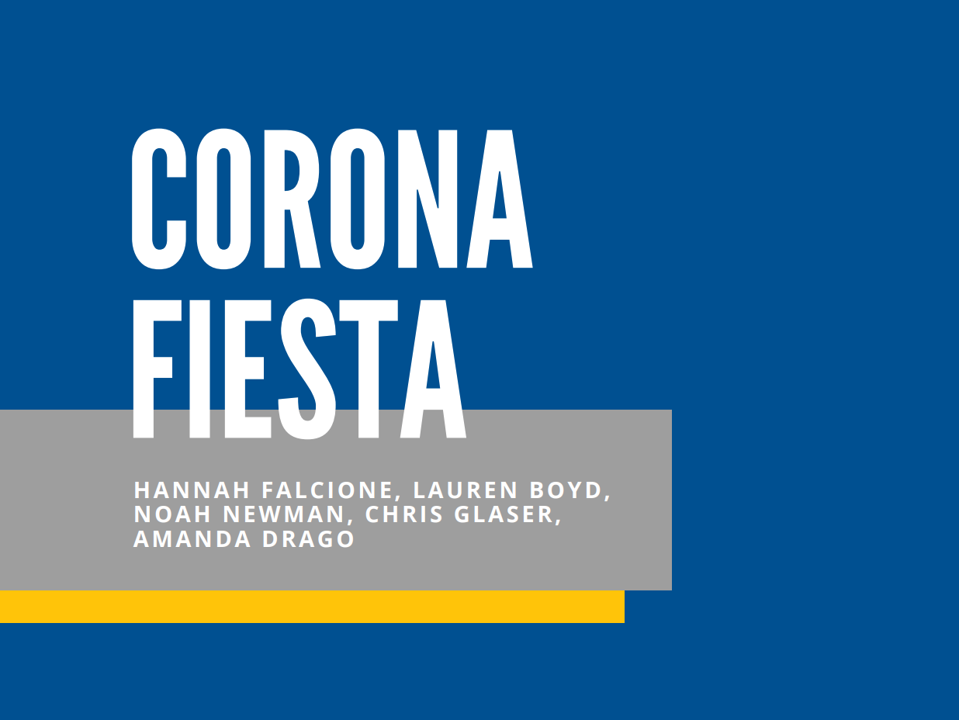

Slide 2
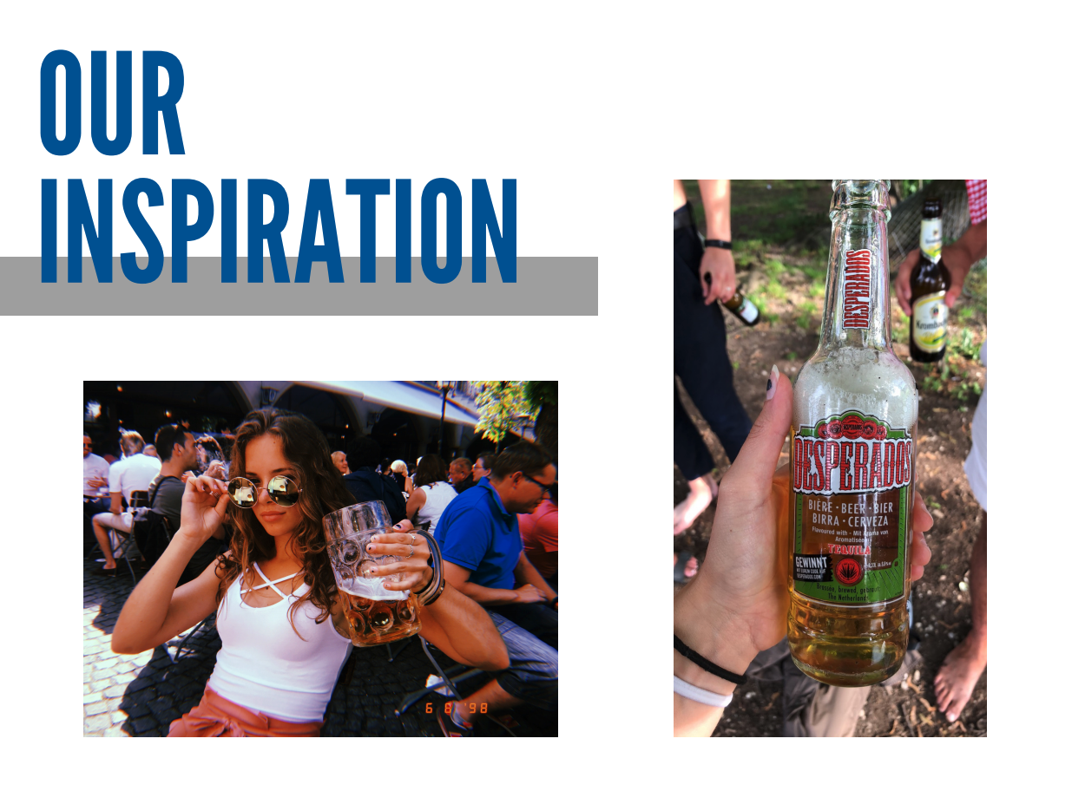
Notes:
Last summer, I had the opportunity to study abroad in Europe and while I was in a bar Spain, I discovered a tequila aged beer called Desperados. I love beer and I love tequila, and I thought to myself “I have to try this”. Not to my surprise, it was amazing. It continued to be one of my favorite beers abroad, but sadly, when I came back to the US, this beer was nowhere to be found. I searched in various stores with no luck, and after doing a little research, realized that it was not being sold in the US. I couldn’t help but wonder why?

Slide 3
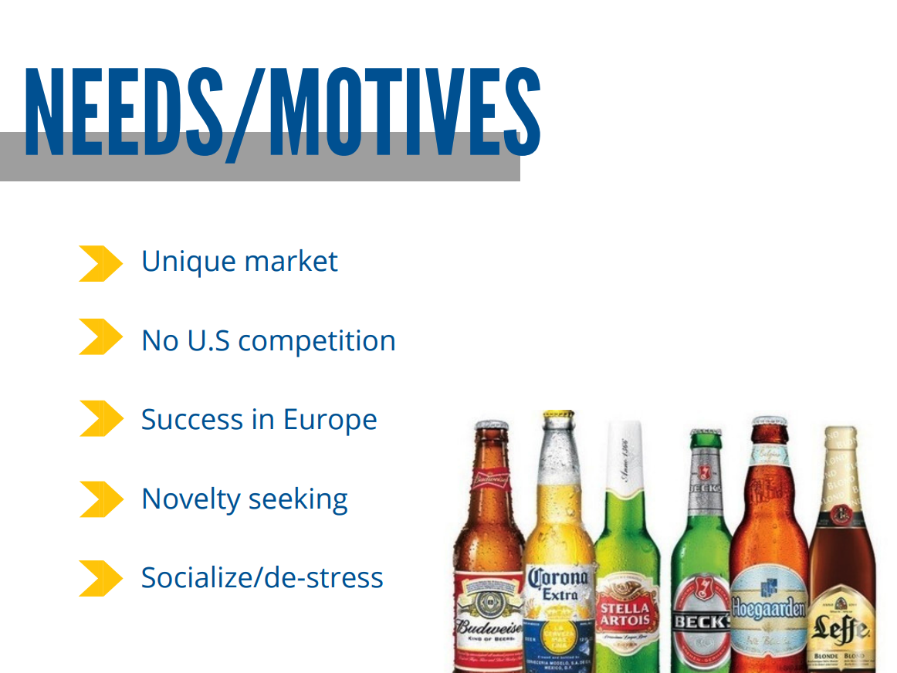
Notes:
Tequila aged beer is a product that is very unique to the beer market. As of now, it is an untouched market in the U.S with no competition, but it hasn’t always been that way. In 2014 Heineken introduced the tequila aged beer, Desperados to the United States, but focused little to none of it’s marketing on this product, causing it to be discontinued as their focuses shifted onto other products. Shockingly enough, this product is currently being sold in 85 European countries. With this current success, we believe there could be great potential in the U.S. In addition to this, a lot of novelty beers have become more popular, such as Rheingist and a few other IPAs, and we believe that people will be motivated to try a novelty beer such as this one with proper marketing. Beer in general is associated with socialization and will satisfy these motives as well.

Slide 4
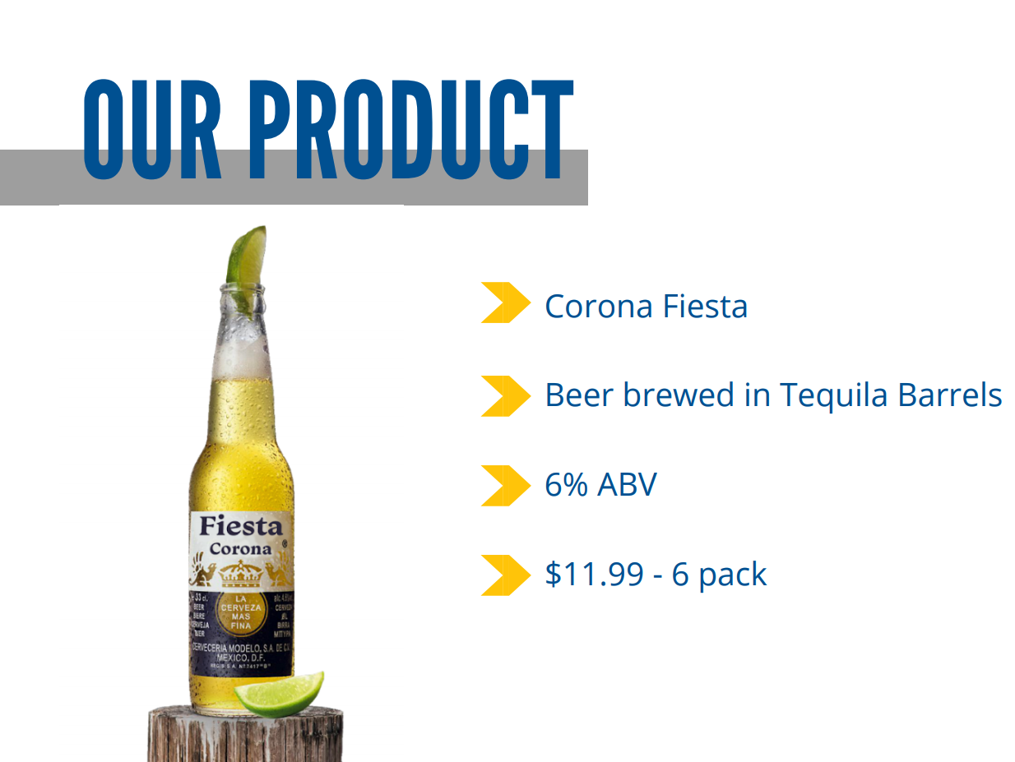
Notes:
To fill the many needs of the unique beer consumer, we present the Corona Fiesta.
This spinoff of corona is unique to the market because it is brewed in tequila barrels.
This raises the alcohol percentage of the drink to 6% normal is 4.6%and gives you the best flavors of tequila without being directly in the product.
Due to the raise in percent and the additional costs of the barrels, we propose a price of $11.99 for a six pack. Normal 6 pack can be purchases at target for 8.99

Slide 5
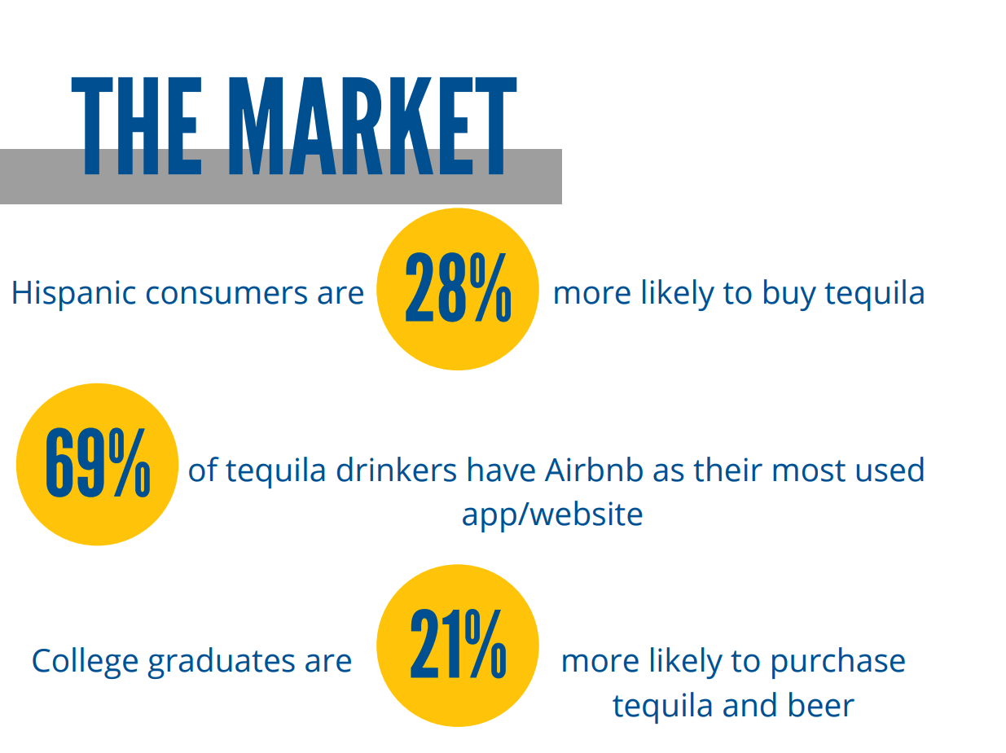
Notes:
In our research we found that Hispanic consumers are 28% more likely to buy tequila. 69% of tequila drinkers have air bnb as their most used app/website and college graduates are 21% more likely to purchase beer and tequila.
This separates out target market into 3 main consumers. 1. The Hispanic consumer 2. Travelers 3. College graduates. Between the ages of 21 - 50 These group are the m
are most likely to buy tequila and beer they are the most plausible consumer of corona fiesta.

Slide 6
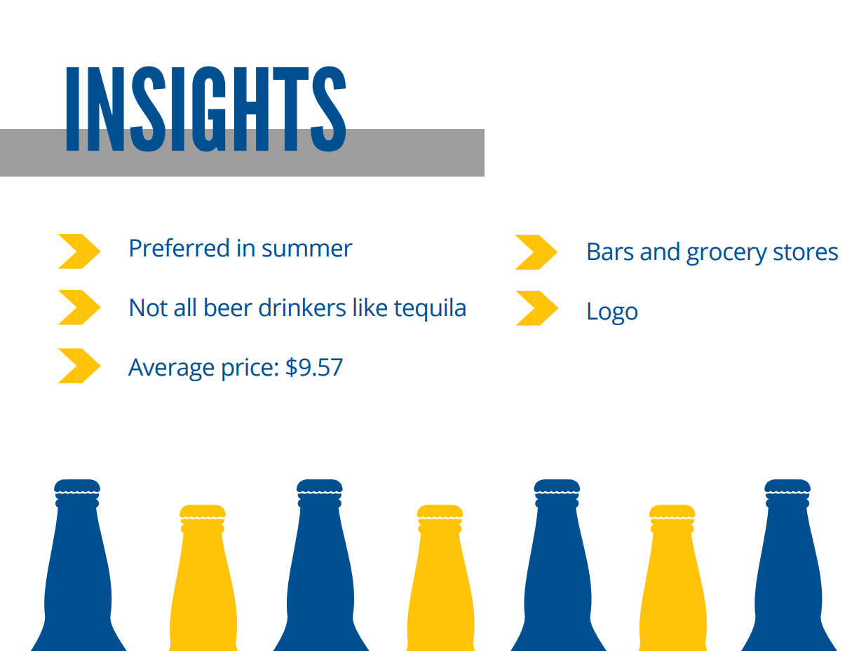
Notes:
For our primary research we did 10 IDI’s ranging from college students to middle aged parents and from these interview we saw a few common themes that we were able to pull into 5 insights
It’s not surprising that when asked what season they chose summer
Beer and tequila are two very different types of alcohol so when marketing we need to be careful
Typical c

Slide 7
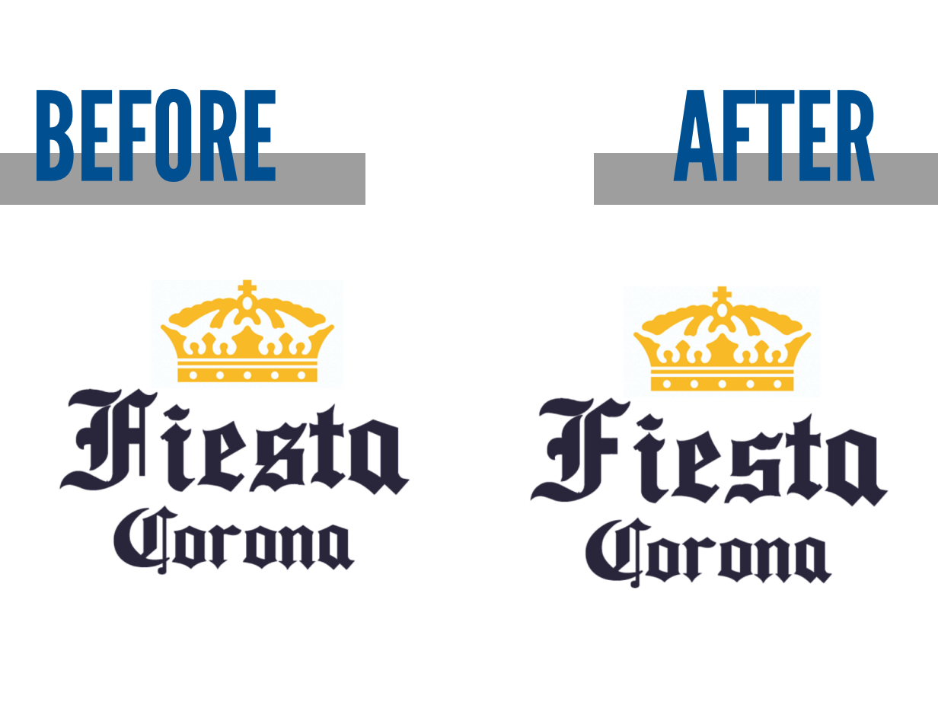

Slide 8
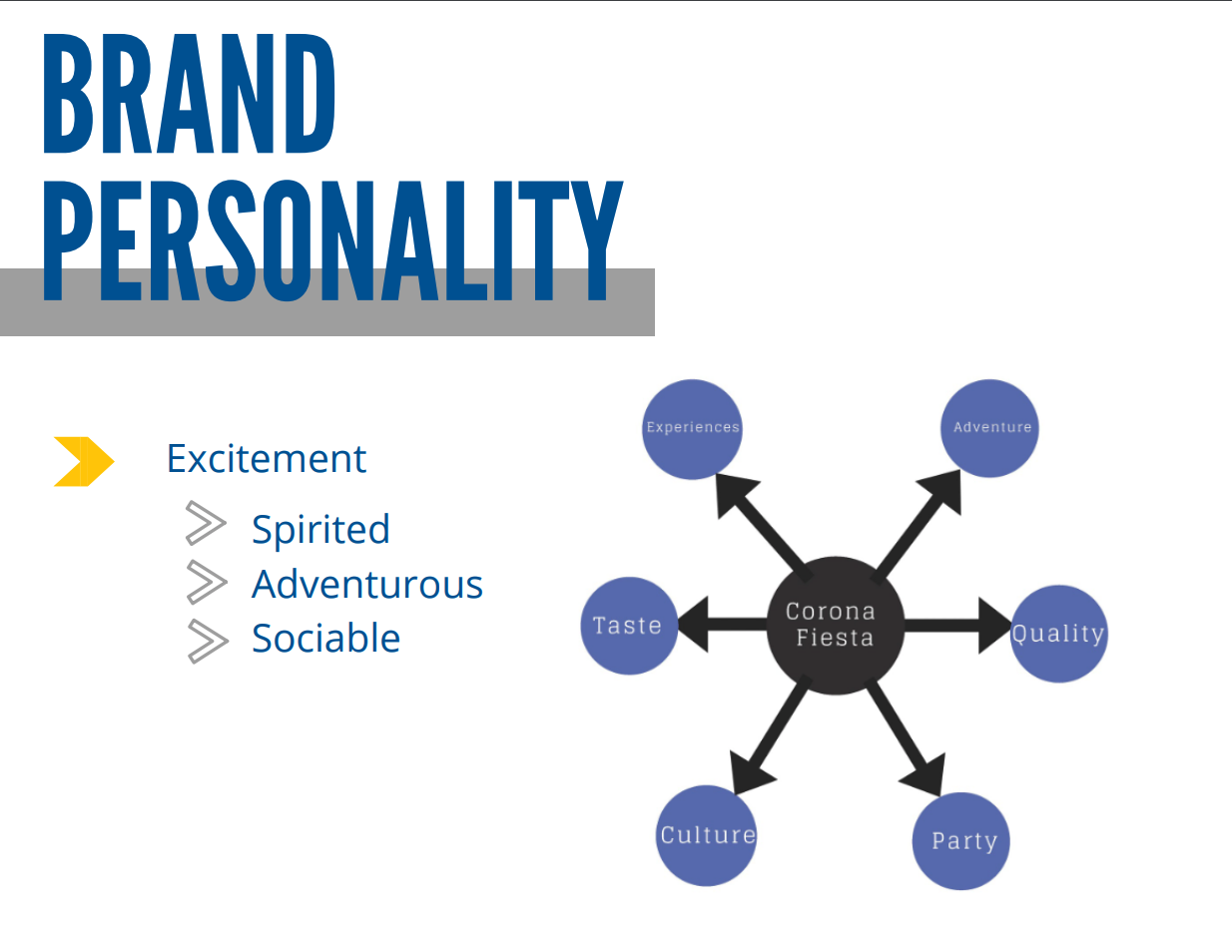
Notes:
Corona Fiesta’s brand personality is excitement, and this is evident in the associative network, where Corona Fiesta is highly associated with culture, party, adventure, and experience. So, we want to make sure consumers see the brand as being spirited, adventurous, and sociable. We would do this through our advertisements. We would have advertisements set at parties to show the fun social aspects or have advertisements show people going on some kind of fun adventure to attract consumers to the brand because it is exciting.

Slide 9
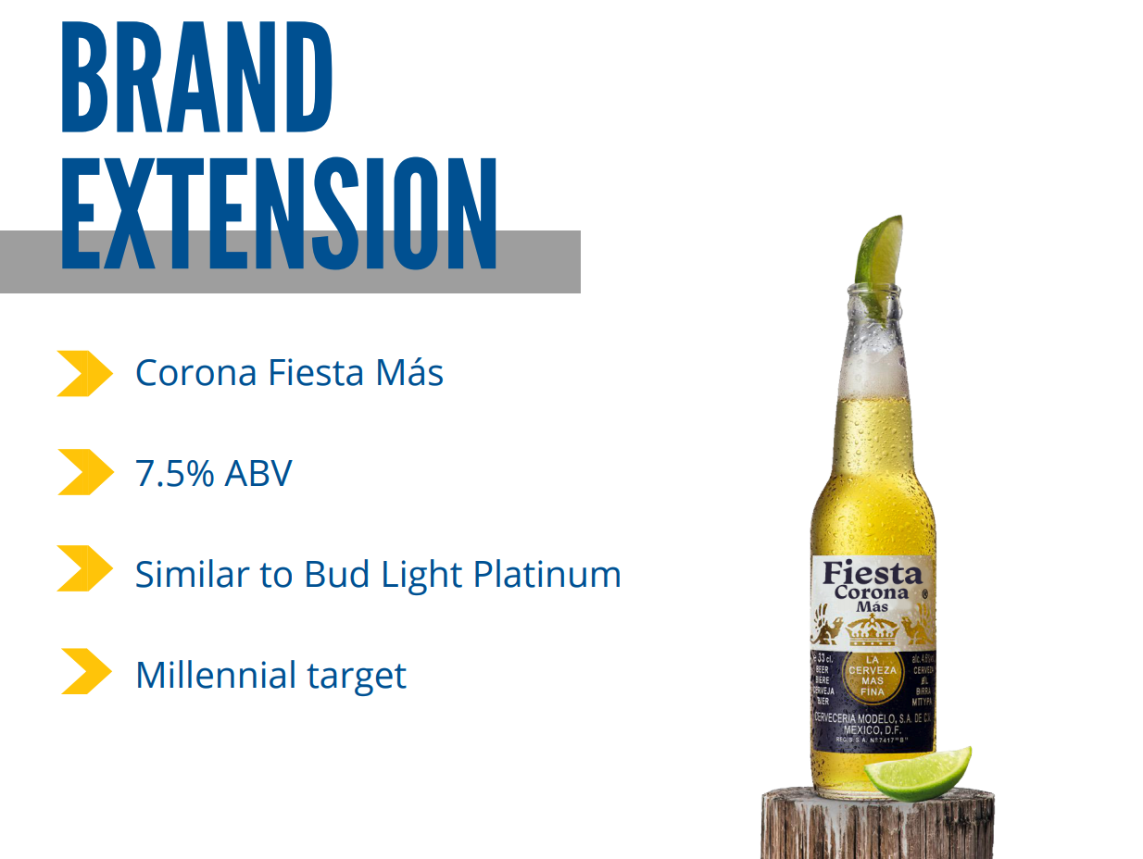
Notes:
After Corona Fiesta is on the market for a couple of years, we would introduce Corona Fiesta Mas. Corona Fiesta Mas is to Corona Fiesta what Bud Light Platinum is to Bud Light. It’s just a higher alcohol content of 7.5%. This is really great for attracting millennials, who tend to like hard liquors and drinks with higher alcohol content. Millennials are great to target because they are already a part of our target market age group, and they are not brand loyal to alcohol yet, so if they really enjoy Corona Fiesta Mas, then they can become brand loyal to Corona Fiesta.

Slide 10
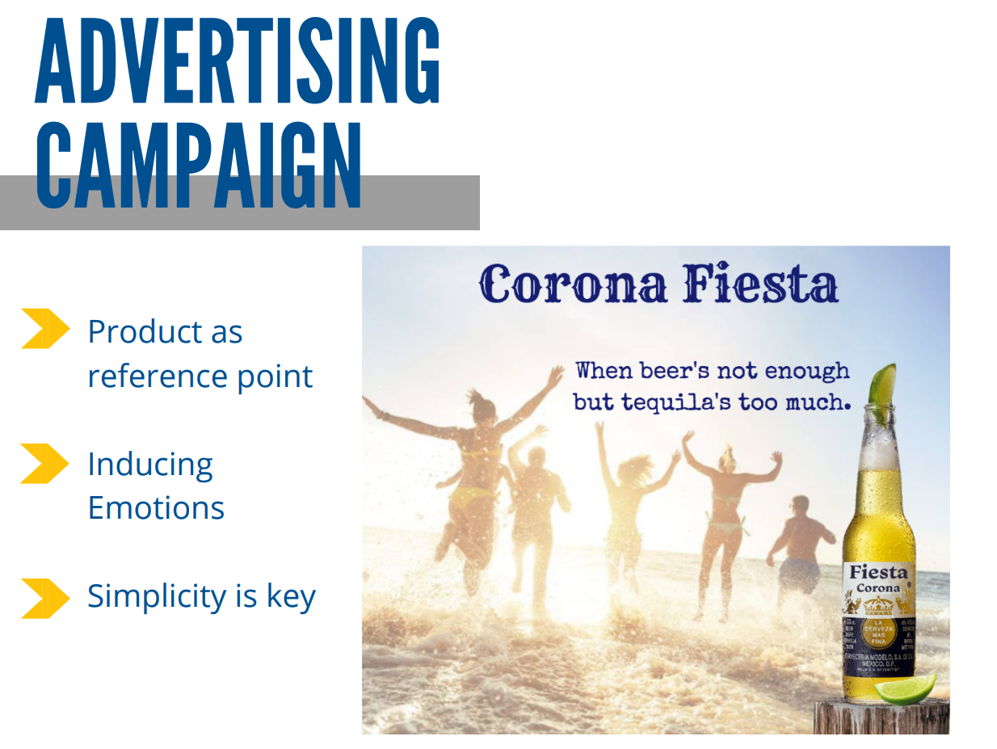

Slide 11

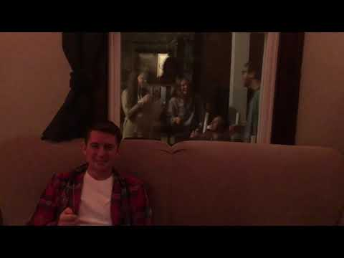

Slide 12
We’ve told you to find your beach
But more important than that…

Slide 13
Is to Find Your Party

Slide 14
Are you ready to join it?

Slide 15
